Slide 1
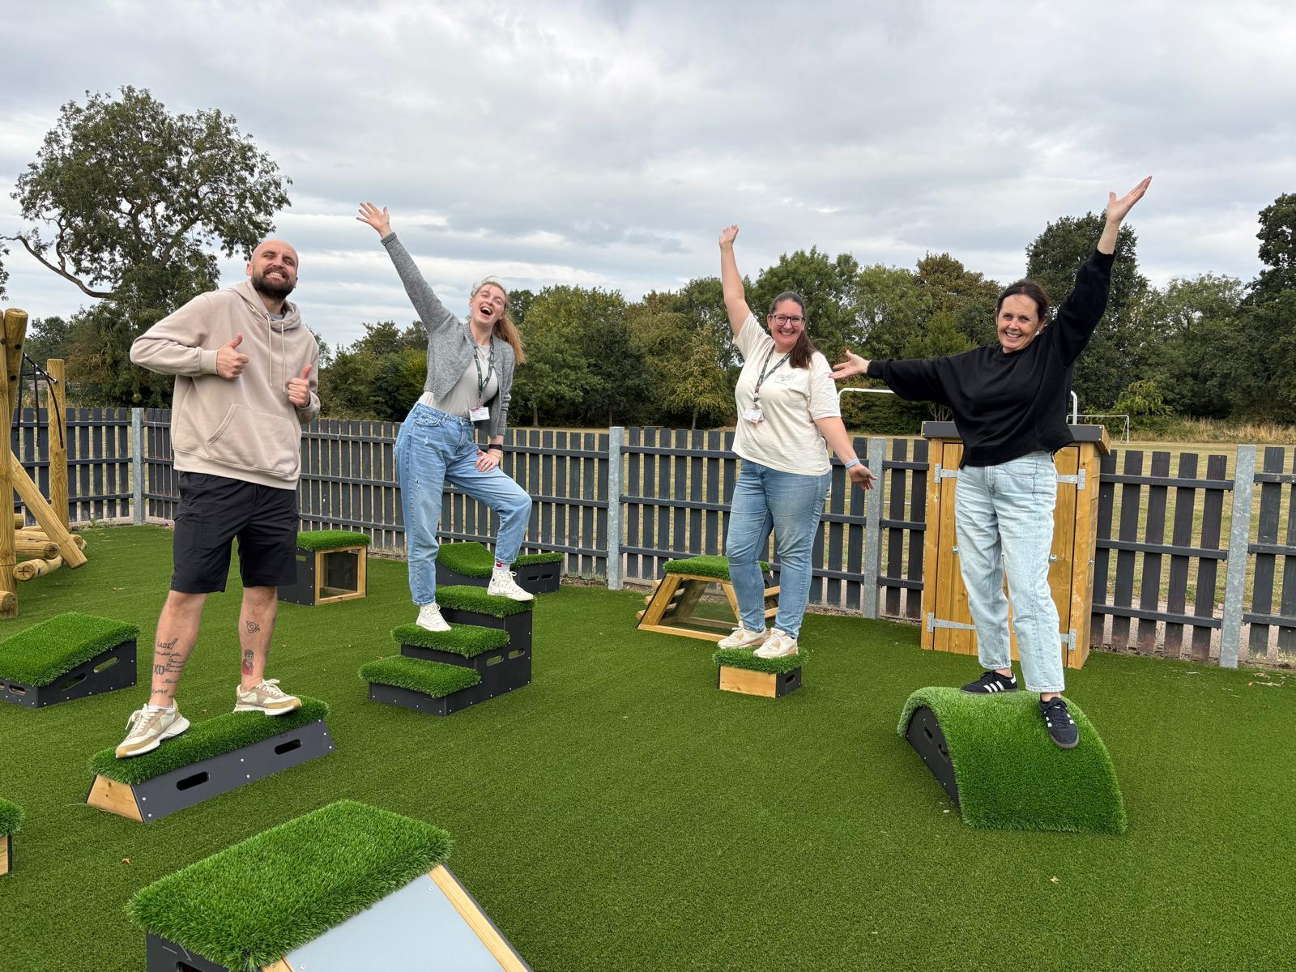
Welcome to Year 4
Mrs Boakes
Mrs Moore
Mr Sargisson
Mrs Tucker

Slide 2

School Values/Learning behaviours
Each of our year groups are ambassadors for our chosen Christian values
Friendship – EYFS
Generosity –Y1
Courage Y2
Thankfulness –Y3
Trust – Y4
Forgiveness -Y5
Justice –Y6
We teach skills that are needed to learn well -Keys To Success
Whole School
Resilience
Persistence
Organisation
Getting Along
Confidence
PLUS WE HAVE R2R CHARACTER MUSCLES:
EYFS- Independence
Y1 – Concentration
Y2- Making connections and asking Questions
Y3- Curiosity
Y4-Managing Impulsivity
Y5-Self-esteem
Y6-Self-efficacy

Slide 3
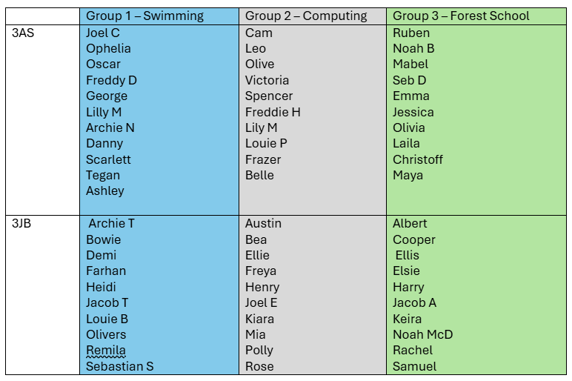
Year Group Organisation
On Monday afternoons, children will be split into 3 groups. One group will have Forest School, one group will be swimming and one group will have a computing lesson. You will be informed of which group your child will be in and what they will need.

Slide 4
Our PE will be on Thursday. Children need to wear white top and grey or black shorts or trousers.
We are in the same classrooms as we were in Year 3, therefore drop off and collection will be from the same area (gates on KS2 playground, near Foundation stage).

Slide 5

Curriculum Overview

Slide 6
Reading
At Sherrier, the expectation is that all children will read at home at least three times every week. On each occasion, the parent or child (if they are in Key Stage 2) must:
•Record the date and name of the text
•Note down how much text has been read
•Comment on the reading taking place
•Initial the comment
•Log the running total of reading nights
In school, there will be continuous monitoring of how often each child has read at home and awards (certificates and stickers) will be handed out to those children reaching set milestones. Children will also receive their ‘star’ on the whole class reading chart displayed within each classroom. Please can you ensure that your child has their reading book/ reading log with them in school on a daily basis. Thank you!

Slide 7
Homework
Homework will be sent home on a Friday and will be due back in on the following Friday.
What is set;
Children are expected to read at least 3 times a week. Adults or children should make a comment in the reading record. Comments could include the name of the text, how much of the text has been read, signature or initial. Additionally, a comment could be made about the reading taking place.
In school, there will be a continuous monitoring of how often each child has read at home.
Please ensure your child has their reading record with them in school on a daily basis.

Slide 8

Class Dojo
Class Dojo has improved the way we communicate and update you on the activities your child is doing in school. It is also used for the following; dates for your diary, sending your child's school reports and dinner menu changes. We will also use it to update you on your child's achievements/behaviour where you will receive a notification on your Dojo App.
Using the message feature:
Class Dojo messages will be received by teachers between the hours of 8.30am - 16:30pm. You may receive a response for these messages during these hours; however, please do not expect a response immediately as it's not always feasible to reply. If your message is urgent then please contact the school office.

Slide 9
Rewards and Sanctions
Please see our school's behaviour policy for our rewards and sanctions.

Slide 10
Getting in touch with us..
Please contact us on Class Dojo if you have a query about anything
Classroom –based staff are with the children during school hours so will be unable to reply between 8.40 and 3.30pm
We love seeing you face to face and will always be happy to talk to you about your child, however please be mindful of the fact that at the beginning of the school day Class Teachers and Support Staff need to be in the classrooms supporting children with their morning tasks. At the end of the day School staff will be focussing on dismissing children safely and therefore may not be able to speak to you.
If your contact is of a more urgent nature during the day please contact the school office and Mrs Lynda Coupland will help you -01455 552791
l.Coupland@sherrier.embracemat.org
If you would like pastoral support for your child please see Mrs Karen Lill outside on the playground or contact the office for her to get in contact with you

