Slide 1

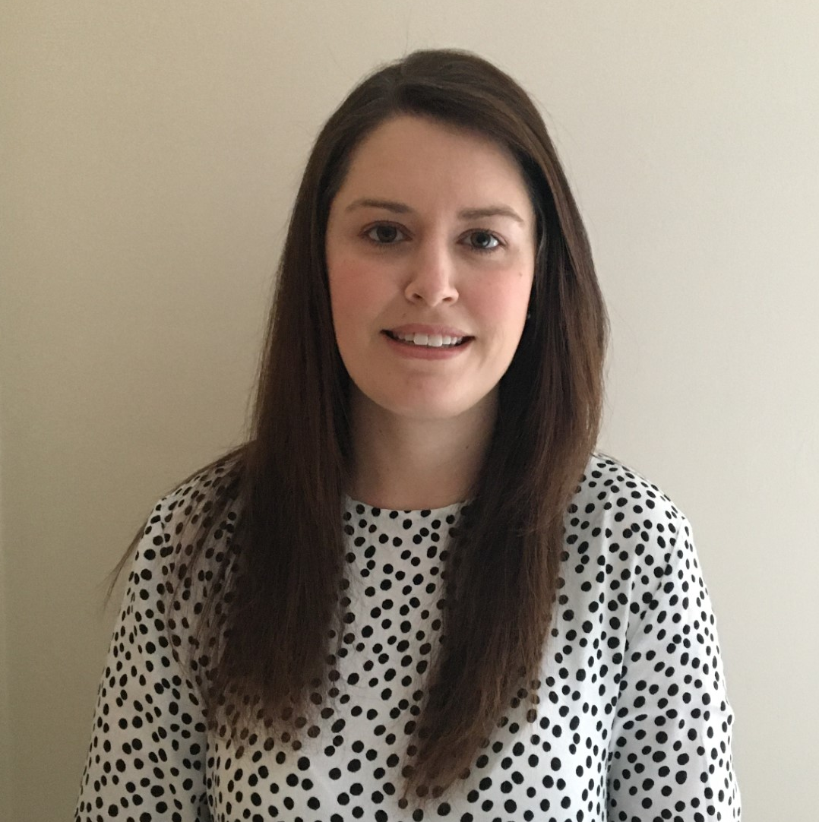
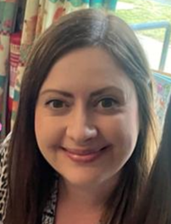
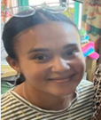
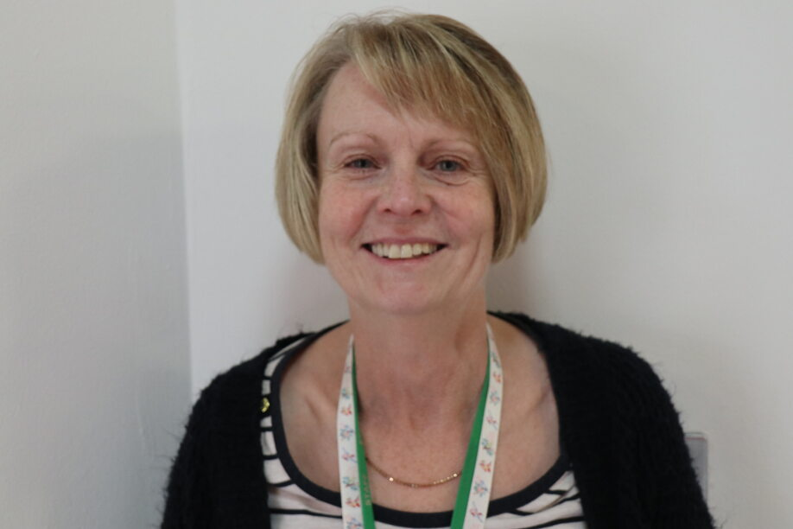
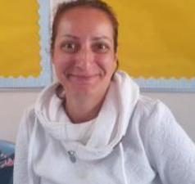
Welcome to Year One
Miss Frangos
Mrs Hunter
Mrs Clay
Mrs Westley
Miss Aneva

Slide 2

School Values/Learning Behaviours
Each of our year groups are ambassadors for our chosen Christian values:
Friendship – EYFS
Generosity – Y1
Courage - Y2
Thankfulness – Y3
Trust – Y4
Forgiveness - Y5
Justice – Y6
We teach skills that are needed to learn well - Keys To Success
Whole School
Resilience
Persistence
Organisation
Getting Along
Confidence PLUS……
EYFS - Independence
Y1 – Concentration
Y2 - Making connections and asking Questions
Y3 - Curiosity
Y4 - Managing Impulsivity
Y5 - Self-esteem
Y6 - Self-efficacy

Slide 3
Year Group Organisation
The Year One classrooms are situated to the left-hand side of the main school office. Each classroom has a named door to identify where your child will enter and then leave at the end of the school day. Year One staff will always be present at the door each morning to welcome the children and will be around at the end of the day too.
In Year One, our PE days will be:
1HC – Wednesday (alternate) and Friday
1GF – Wednesday (alternate) and Friday
On alternate Wednesdays, your child will be taking part in a Forest School session so they must attend school wearing their Sherrier school uniform that is appropriate to being outside and the weather conditions. Please can you also ensure that your child has a pair of named wellington boots in school at all times. Thank you!

Slide 4
Curriculum Overview
During the Autumn Term, the children will be making their transition into Key Stage One through approaching the curriculum with a combination of exploratory and focused, independent activities.
As the year progresses, the children will actively take part in daily Writing, Maths, Phonics and Reading (VIPERS) sessions. Throughout the year, our topics will be the ‘Great Fire of London’, ‘Discovery Island’, and ‘Local Nature Study’, which will incorporate a wide range of curriculum areas.
Great Fire of London (Autumn Term) – History, Art, Geography, D&T and Music
Discovery Island (Spring Term) – Geography, History, Science, Music and D&T
Local Nature Study (Summer Term) – Science, Geography, Art, Music and D&T
Alongside our core subjects, the children will also take part in regular sessions of Religious Education (RE), Jigsaw, and Computing.

Slide 5
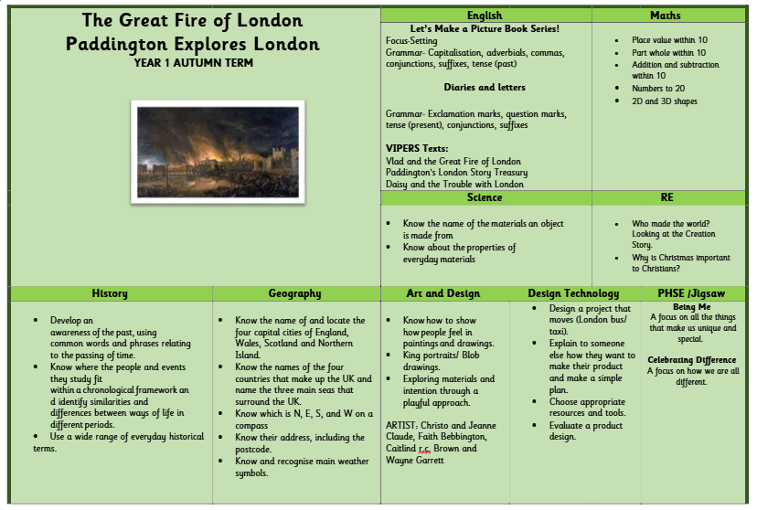
Autumn Overview

Slide 6
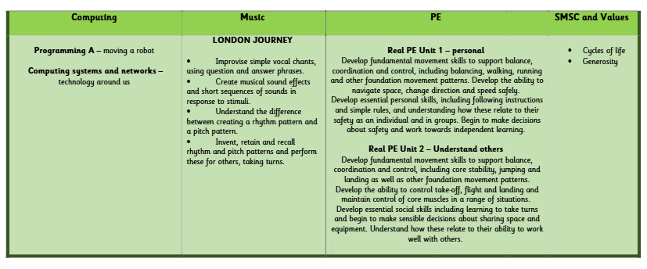
Autumn Overview

Slide 7

English
For the Autumn Term, the children shall be focusing on establishing their fundamental skills in order to develop as successful writers. In a creative manner, the children will write for different purposes whilst enhancing their pencil grip, posture, handwriting (letter formations) and letter spacing.
The children will have the opportunity to write lists, labels, captions and accurately punctuated sentences, as part of our role working as a team (The Treasure Transporters) to safely deliver unique and valuable items around the country. As the term progresses and we begin our ‘Great Fire of London’ topic, the children will become authors where they will draft, edit and publish picture books, as well as diaries and letters.
In addition to this, the children will be receiving daily Phonics sessions with Fred the frog, which will support their knowledge of sounds, as well as their skills in blending and segmenting.

Slide 8

Reading
At Sherrier, the expectation is that all children will read at home at least three times every week. On each occasion, the parent or child (if they are in Key Stage 2) must:
Record the date and name of the text
Note down how much text has been read
Comment on the reading taking place
Initial the comment
Log the running total of reading nights
In school, there will be continuous monitoring of how often each child has read at home and awards (certificates and stickers) will be handed out to those children reaching set milestones. Children will also receive their ‘star’ on the whole class reading chart displayed within each classroom. Please can you ensure that your child has their reading book/ reading log with them in school on a daily basis. Thank you!

Slide 9
Homework
In Year One, homework tasks will all focus on core learning skills. The tasks will gradually be introduced to the children throughout the Autumn Term. Homework will be set weekly but shall be reviewed every Wednesday.
Reading – All children will be expected to read at home at least three times a week, which must be recorded within their home reading journals (Kluwell booklets).
Maths – This is a paper based X-Factor arithmetic sheet. One side will be completed in class and the reverse side is to be completed at home. When children receive a certain percentage, they will move up the rounds.
Phonics/spelling – To be confirmed. Please bare with us.

Slide 10
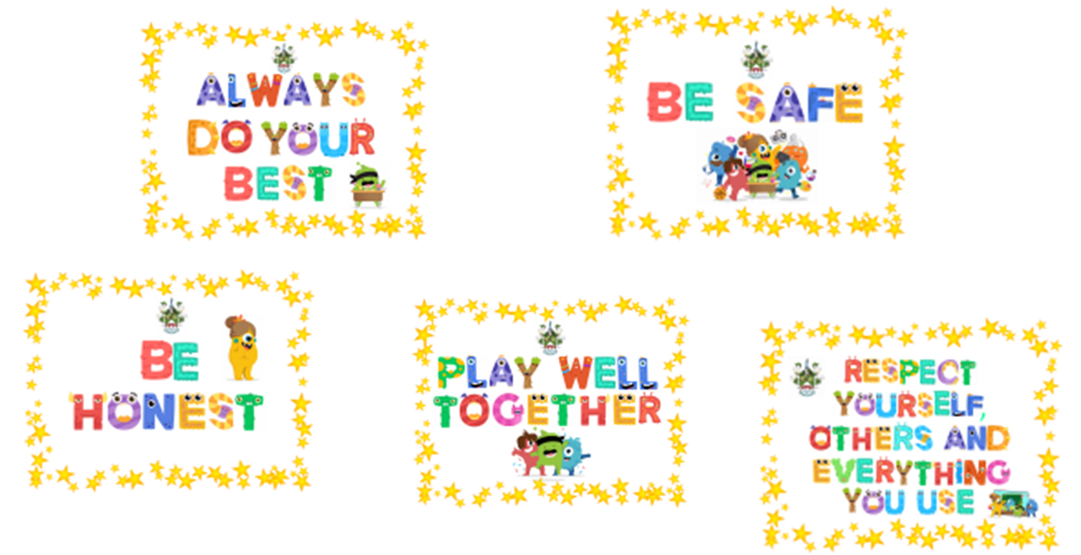

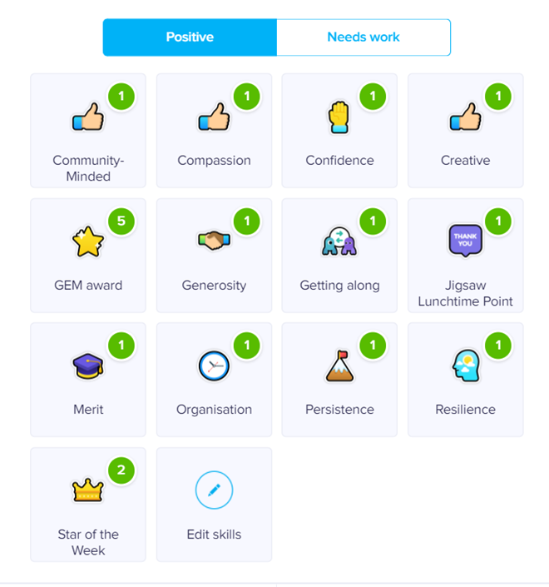
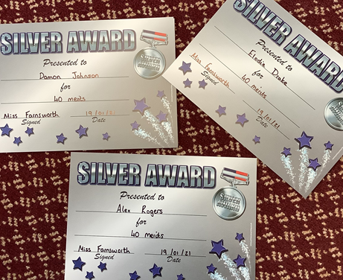
Rewards and Sanctions
Merits – Given to children for their own learning, recorded on Dojo under merit section. Every 20 gets a certificate.
Dojo – Given to children for different positive reasons.
GEM Award - Going the Extra Mile – A special visit to Miss Beckett to receive a certificate and a prize!
Star of the Week - Every Friday a member of each class will be awarded a Star of the Week certificate and receive this in a special assembly.
Jigsaw Lunchtime Award - Given by staff in the form of a Pom Pom and goes towards a collected team point system.
Sanctions
Red Card – More serious incidents such as physical contact or if the behaviour chain has been reached twice in a day. Recorded on Dojo and parents to be informed.

Slide 11

Getting in touch with us…
For any urgent and/or time-sensitive messages or queries, please contact the School Office as your first port of contact. This includes last-minute changes to collection arrangements, notifying us of illness etc.
This ensures that important information is received promptly as classroom-based staff are with the children during school hours so will not see Dojo messages. This also avoids messages being missed if a staff member is not in school.
We love seeing you face to face and will always be happy to talk to you about your child, however, please be mindful of the fact that at the beginning of the school day class teachers and support staff need to be in the classrooms supporting children with their morning tasks. At the end of the school day, school staff will be focussing on dismissing children safely and therefore may not be able to speak to you.

